Slide 1

Guide to voting

Slide 2
Practical guide to voting

Slide 3
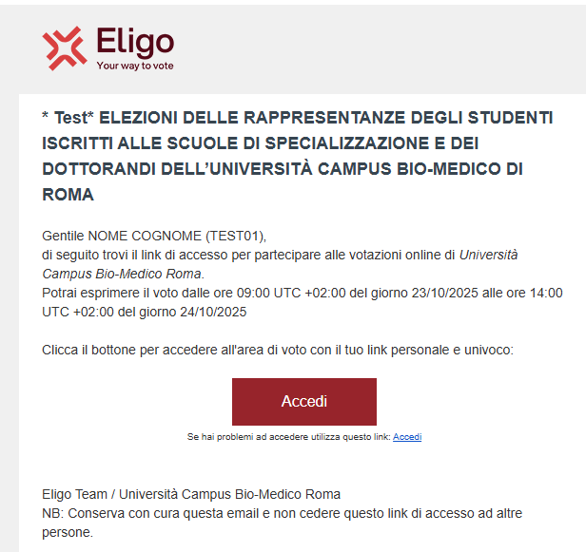
Email with login Link
A few days before the vote, you will receive your personal link via email to connect to the voting area (ACCEDI). You will only be able to access open voting, at the times indicated in the email
Subject: Eligo Evoting - Credentials of namesurname – Vote title. Sender: notifica@evoting.it

Slide 4
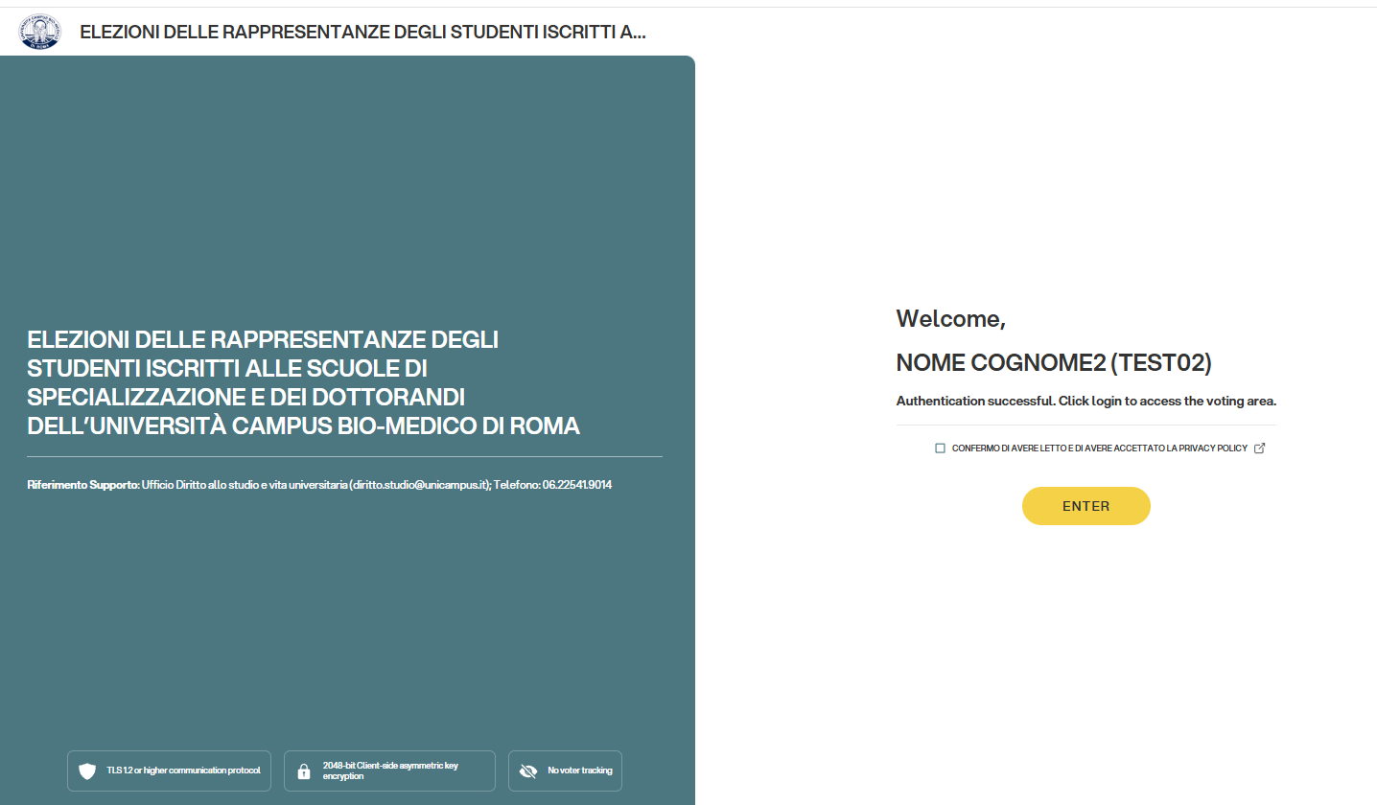
Access the voting area
Check that your name is correct.
Accept the privacy policy and click on “ENTER”

Slide 5
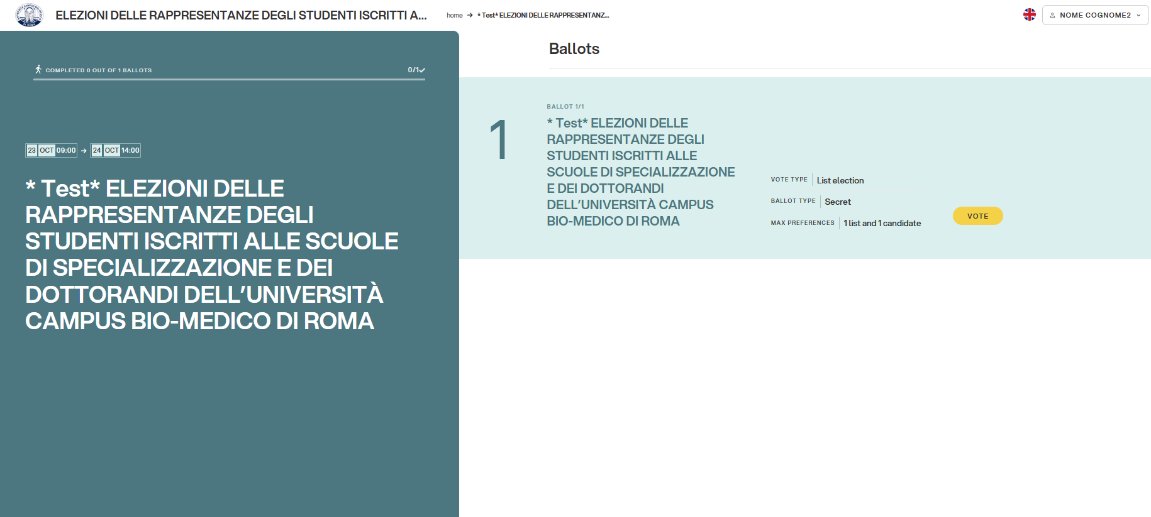
Ballot (s)
The ballot (s) to be voted on will be displayed.
Click on “vote” to open the first voting ballot.

Slide 6
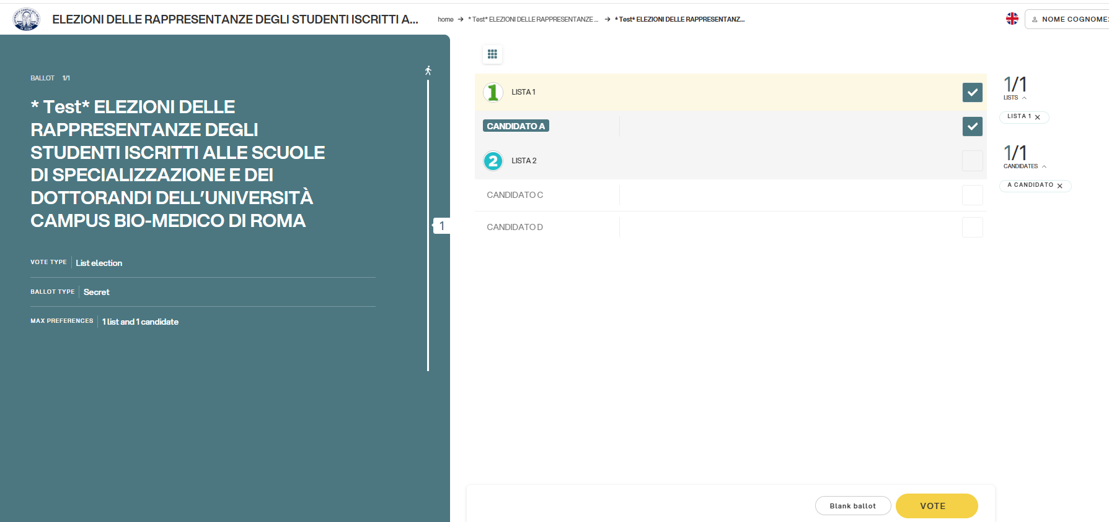
Cast your vote.
To cast your vote, select the box relating to the chosen candidate or the list to assign preference.
Click on “VOTE“.
Please note: Voting for different lists is not permitted.
Please note: you can click on “Vote“ or select “Blank ballot” if you do not intend to assign any preferences.

Slide 7
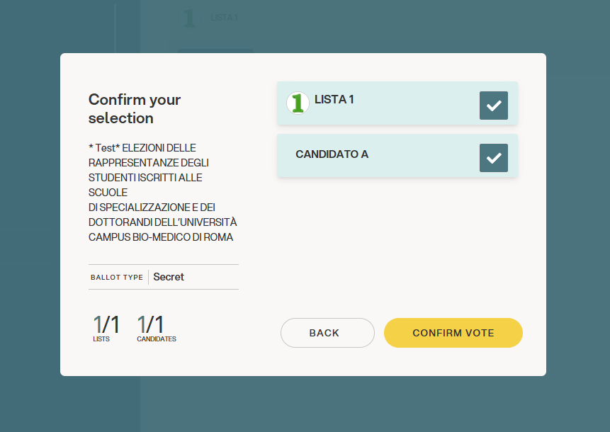
Confirm your vote.
Once the vote has been assigned, the vote summary page is presented, like the example here shown.
The vote is placed in the digital ballot box, only after this step.
By pressing «Confirm Vote» the vote becomes unchangeable.

Slide 8
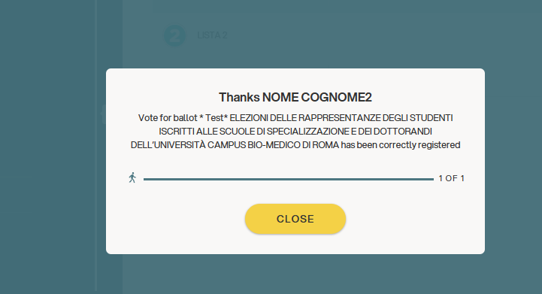
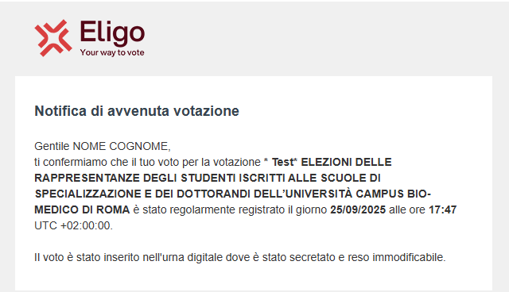
Vote confirmed.
Once confirmed, the vote will be unchangeable.
DO NOT close your browser or turn off your PC.
Click on “continue” if there are other voting ballots or click on “close” to finish the voting operations.
In the meantime, an email with the voting receipt will be sent.

Slide 9
Viale Monte Nero 17, Milano +02 80511 31 supporto-eligo@evoting.it
Copyright © 2024 ELIGO | ID Technology S.r.l. P.IVA: 11240660156

