Slide 1
ADVANCED MANUFACTURING PROCESSES FOR TISSUE ENGINEERING
Alberto Rainer, PhD
Unit of Tissue Engineering & Chemistry for Engineering
a.rainer@unicampus.it

Slide 2
REGENERATIVE MEDICINE
transplantation of tissue engineering constructs
scaffold acts as a supporting framework for cell delivery
ADVANCED IN VITRO MODELS
integration of chemical and biochemical cues in a 3D system
recapitulation of a 3D tissue models
TISSUE ENGINEERING

Slide 3
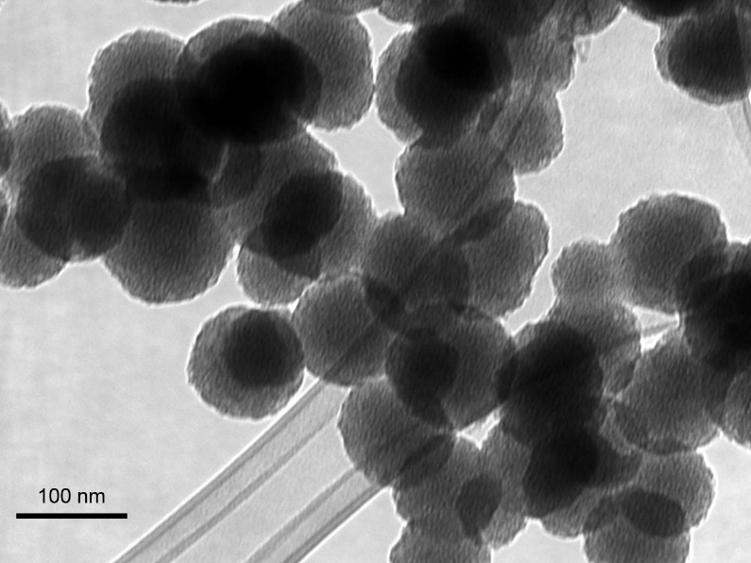
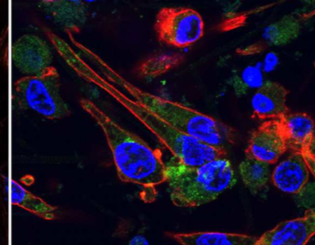
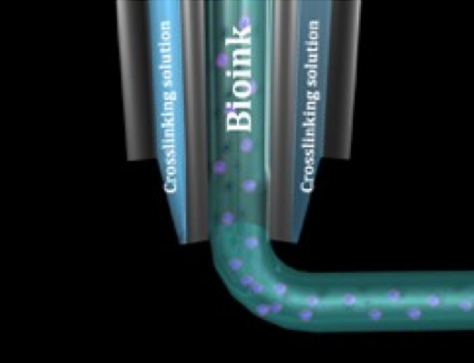
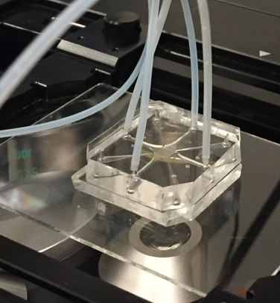
UNIT & RESEARCH ACTIVITIES
Multidisciplinary unit composed of chemists, engineers and biologists.
Synthesis of novel biomaterials
Chemical & biological characterization of biomaterials
Advanced manufacturing processes
Cell/organ-on-a-chip models
  electrospinning
  additive manufacturing

Slide 4
ELECTROSPINNING

Slide 5
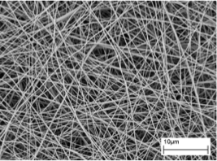
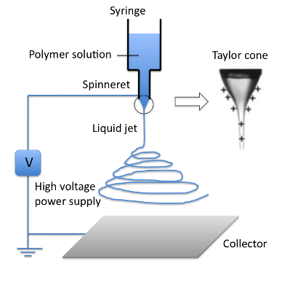
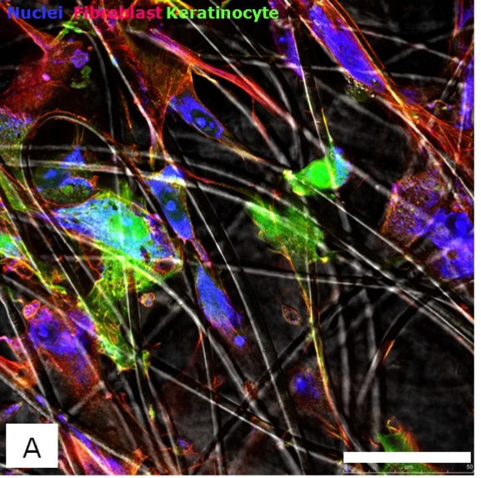
ELECTROSPINNING – PROCESS OPTIMIZATION (DOE)
Electrospinning is a popular scaffold fabrication technique, giving direct access to nanomaterials.
Electrospinning exploits an intense electric field to extract polymeric nanofibers from a solution, and depositing them as a non-woven material. Fibers mimic the ECM and find wide application in TE. However, the process is hampered by a ‘trial and error’ approach.
Our work was an attempt to rationalize electrospinning process, describing the influence of process variables on the resulting microstructures using a Design of Experiments (DOE) method.
Seyedmahmoud R, Rainer A, Mozetic P, et al. A primer of statistical methods for correlating parameters and properties of electrospun poly(L-lactide) scaffolds for tissue engineering--PART 1: design of experiments. J Biomed Mater Res A. 2015 Jan;103(1):91-102.
Seyedmahmoud R, Mozetic P, Rainer A, et al. A primer of statistical methods for correlating parameters and properties of electrospun poly(L-lactide) scaffolds for tissue engineering--PART 2: regression. J Biomed Mater Res A. 2015;103(1):103-14.

Slide 6
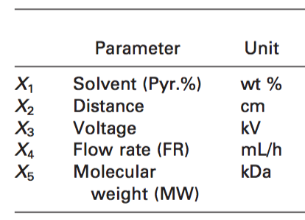
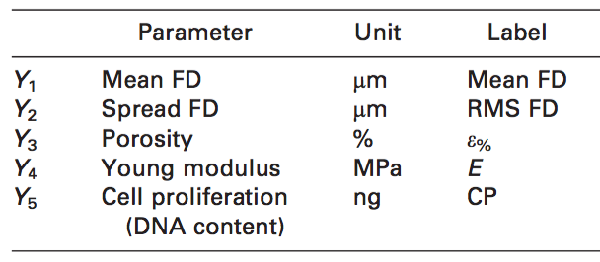
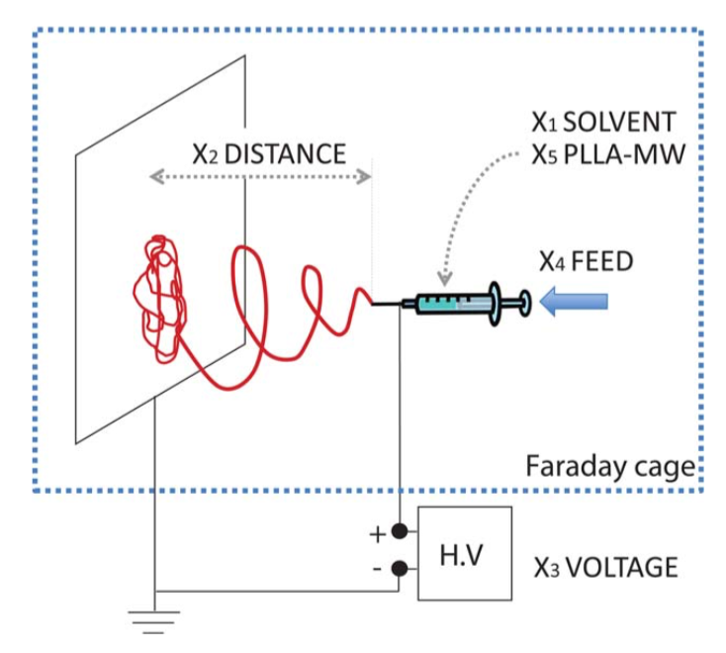
ELECTROSPINNING – PROCESS OPTIMIZATION (DOE)
ideally: “to describe scaffold morphology as a function of process parameters…”

Slide 7
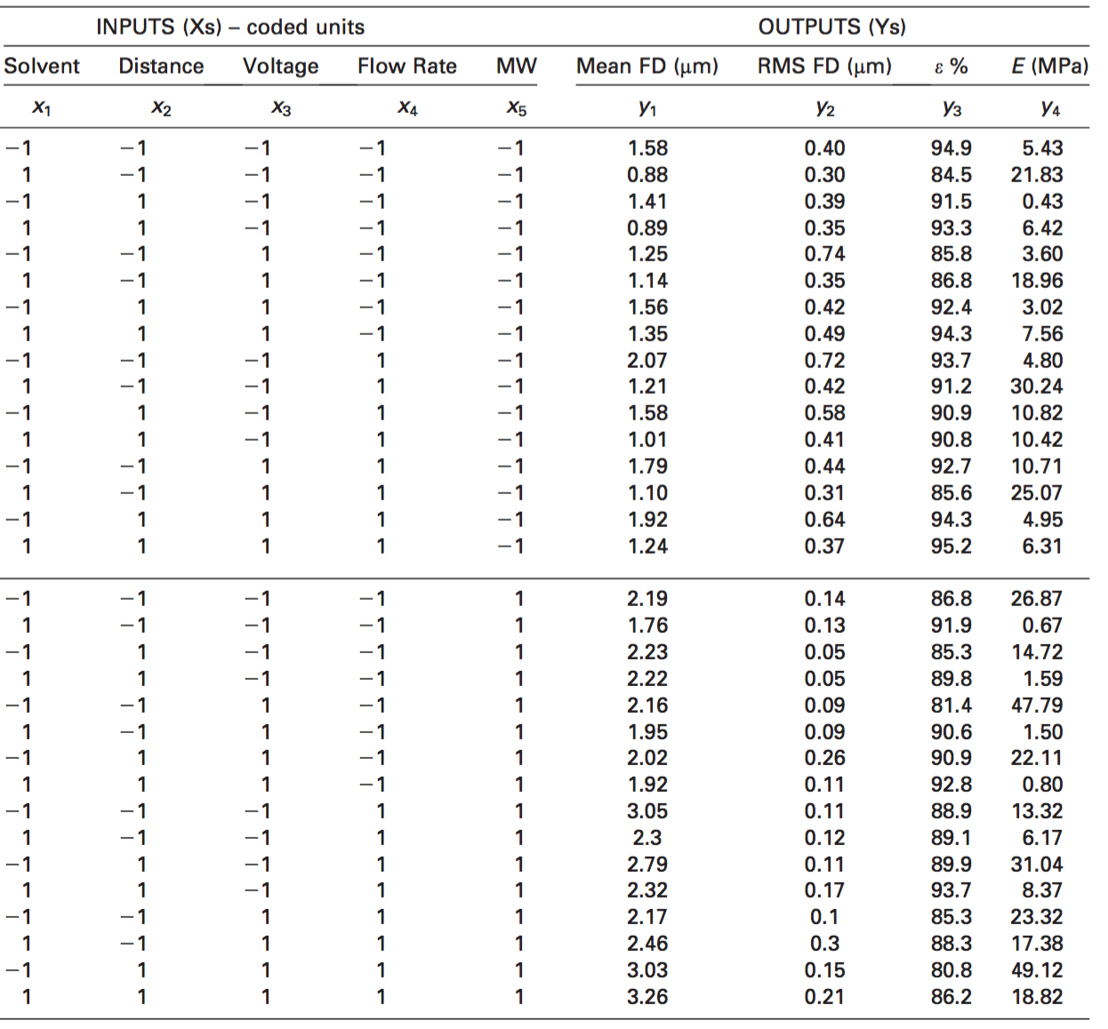
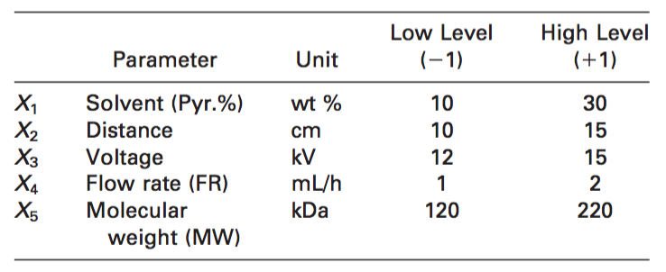
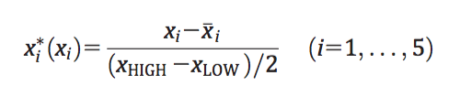
2^{k} FACTORIAL DESIGN
Discrete values assigned to X_{1–5} process parameters.
Linear transformation to obtain “coded” variables from linear ones.
Standard Order of Treatments in Coded Variables and Mean Response Y_{1–4}

Slide 8


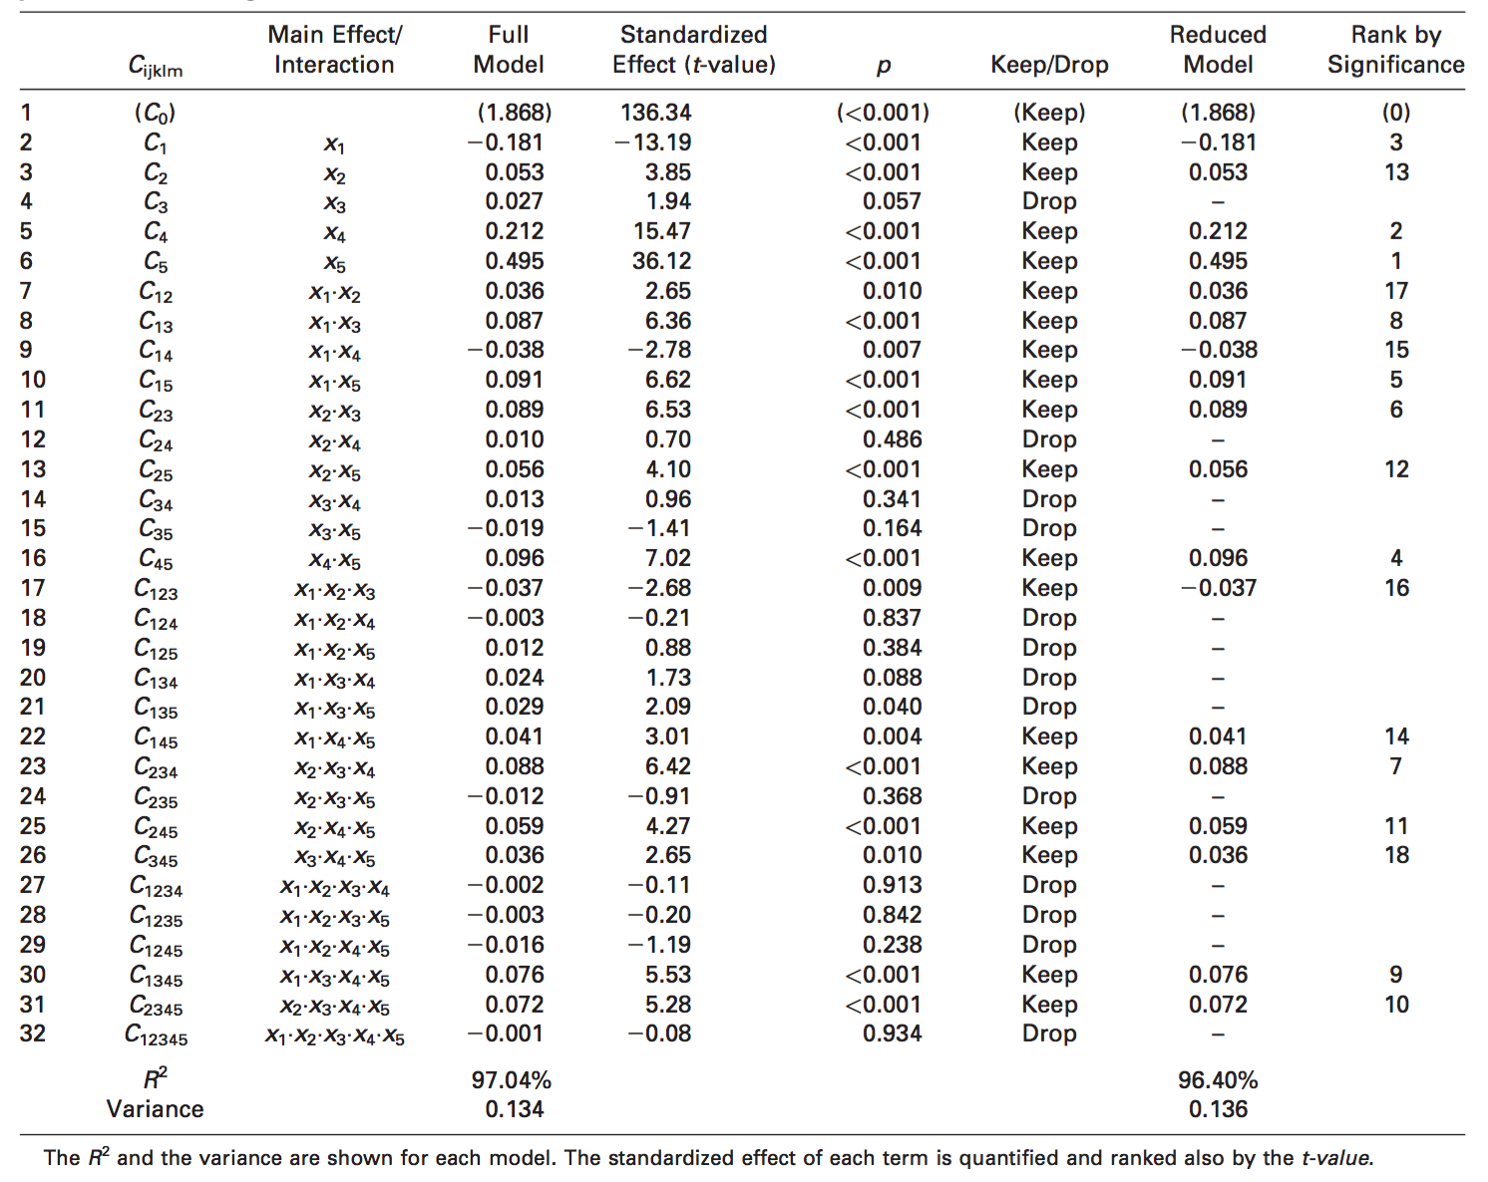
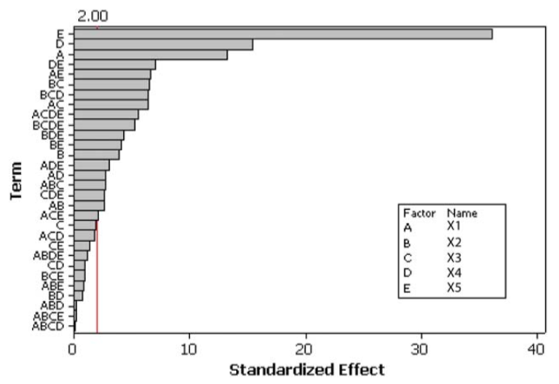
Representative results for Y1 (mean diameter):
Seyedmahmoud R, Rainer A, Mozetic P, et al. A primer of statistical methods for correlating parameters and properties of electrospun poly(L-lactide) scaffolds for tissue engineering--PART 1: design of experiments. J Biomed Mater Res A. 2015;103(1):91-102.
Seyedmahmoud R, Mozetic P, Rainer A, et al. A primer of statistical methods for correlating parameters and properties of electrospun poly(L-lactide) scaffolds for tissue engineering--PART 2: regression. J Biomed Mater Res A. 2015;103(1):103-14.
strong dependence upon X5 (molecular weight)

Slide 9
ADDITIVE MANUFACTURING

Slide 10
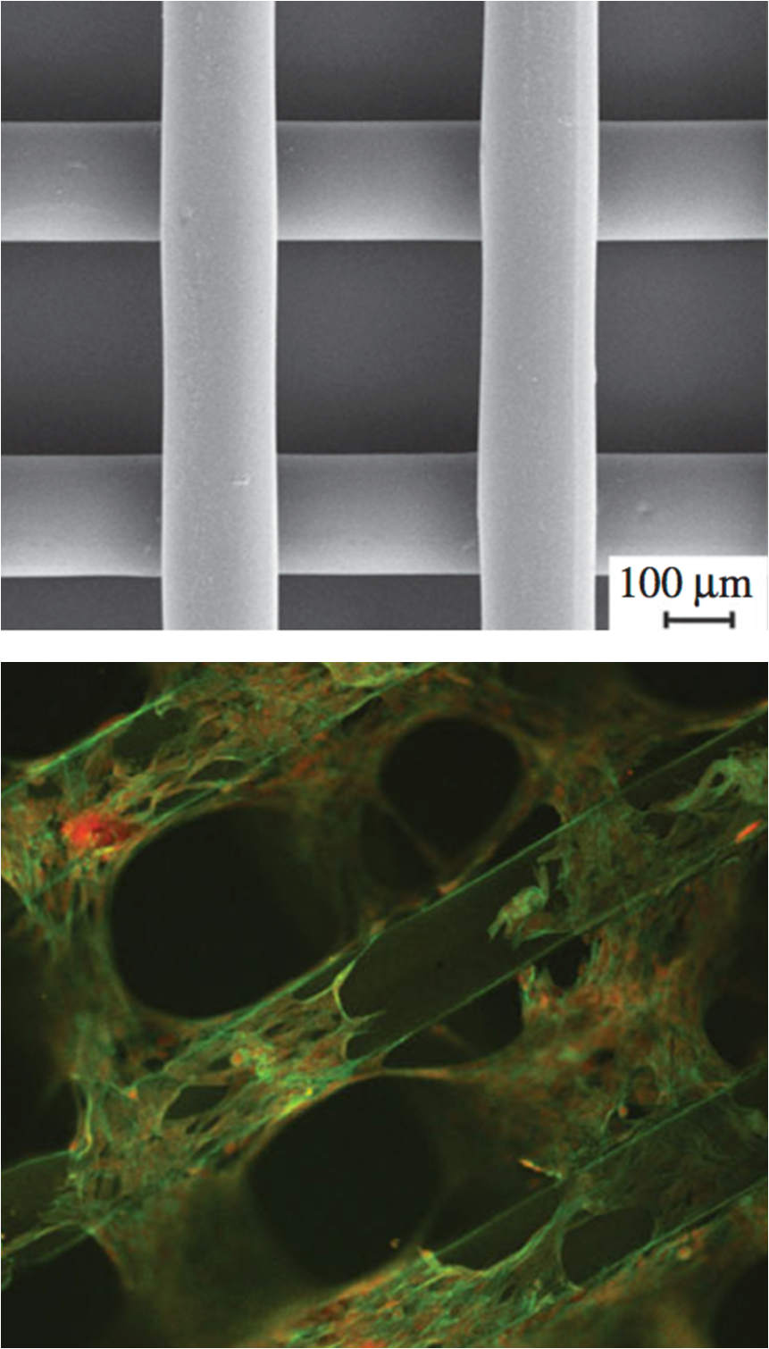
COMPUTER AIDED TISSUE ENGINEERING
Application of additive manufacturing (also known as rapid prototyping) techniques to tissue engineering is rapidly revolutionizing tissue engineering.
Free form fabrication of multi-material constructs with complex shapes, that were unachievable with conventional techniques.
Production of 3D porous substrates (scaffolds) for tissue engineering.
Example: highly compliant polyurethane scaffolds for myocardial tissue engineering (MIUR FIRB “Future in Research” 2010).
Chiono V, Mozetic P et al. Polyurethane-based scaffolds for myocardial tissue engineering. Interface Focus, 2014:4;20130045.

Slide 11
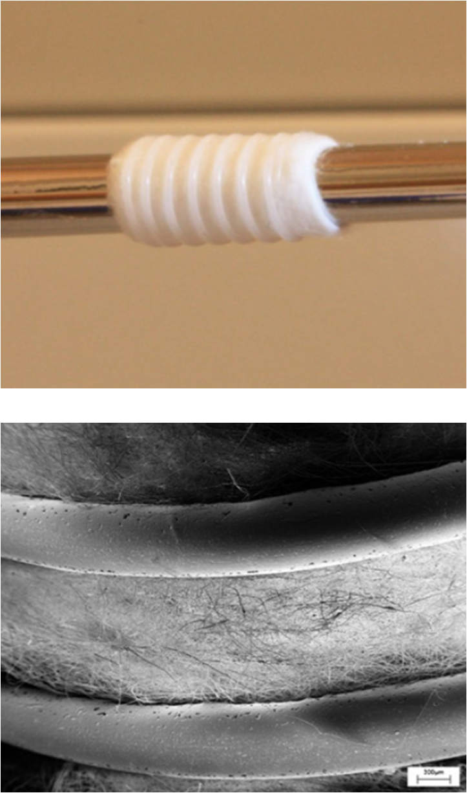
LIMITATIONS OF CONVENTIONAL ADDITIVE MANUFACTURING
While 3D printing of thermoplastic biopolymers is an established technique for the production of e.g. bone grafts, the process has severe limitations for soft tissues.
Major issues regard: i) limited choice of materials; ii) low resolution; iii) smooth surface hampering cell adhesion.
Combination of additive manufacturing with other techniques to improve scaffold performances → hybrid additive manufacturing.
Giannitelli S, Mozetic P, Trombetta M, Rainer A, Combined additive manufacturing approaches for tissue engineering, Acta Biomaterialia, 2015;24:1-11.
Centola et al. Biofabrication (2010).

Slide 12
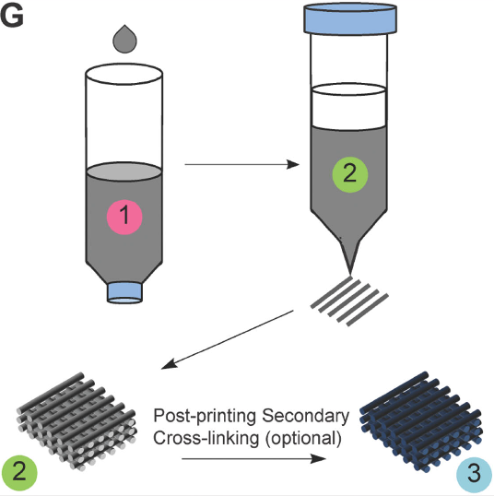
BIOPRINTING OF THERMOSENSITIVE HYDROGELS
Another major criticality to the widespread diffusion of CATE is represented by the processing of hydrogels.
Current technologies are often hampered by low resolution and harsh processing conditions.
Incorporation of living cells in the hydrogel (i.e. bioprinting) still represents a major challenge.
As an outcome of FIRB project, we have developed a process exploiting thermosensitive hydrogels for a cell-compatible bioprinting.
Italian patent application 102015000020718: Metodo per la preparazione di costrutti cellularizzati a base di idrogeli termosensibili tramite tecnica di prototipazione rapida (2015).

Slide 13
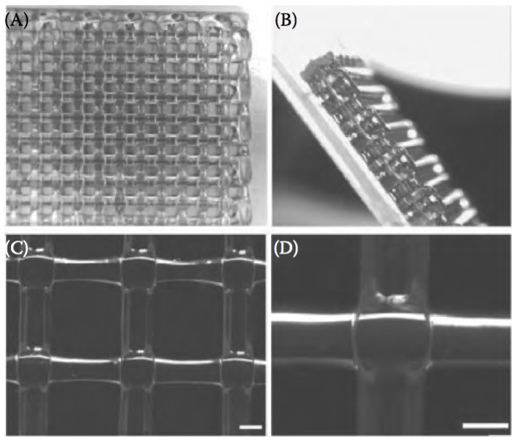
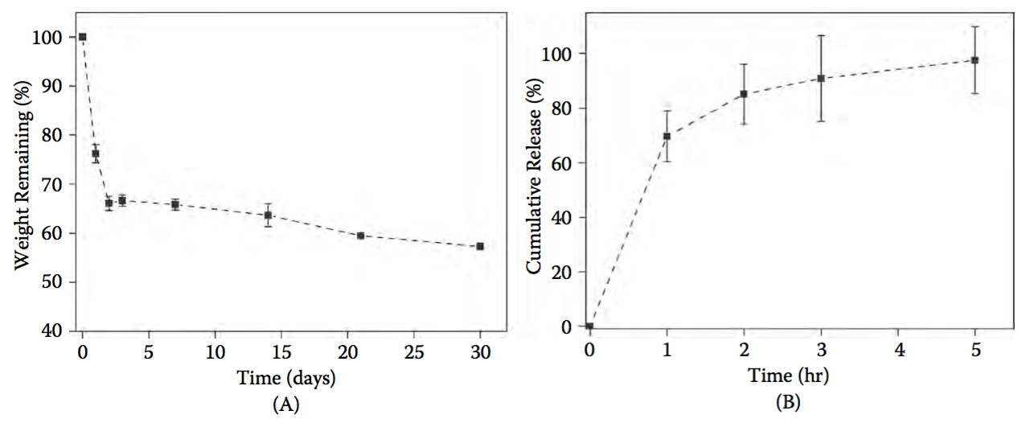
FURTHER IMPROVEMENTS
Development of composite bioinks containing a thermosensitive polymer (e.g. a commercial poloxamer) blended to other biopolymers (e.g. alginate).
The poloxamer confers instant gelation and shape fidelity, while a second crosslinking step (Ca⁺⁺-induced alginate gelation) provides long term stability.
The system has been successfully tested in combination with different cells, showing excellent biocompatibility.
The templating poloxamer component is rapidly eluted from the hydrogel, which maintains its 3D structure.
The material has also been investigated as a potential drug delivery system.
Giannitelli SM, Mozetic P, Trombetta M, Rainer A, Additive Manufacturing of Pluronic/Alginate Composite Thermogels for Drug and Cell Delivery, in Additive Manufacturing: Innovations, Advances, and Applications. Srivatsan TS, Sudarshan TS (eds.), Taylor & Francis, 2015.
Awarded at Advanced Functional Polymers in Medicine, Galway, 2015 (best poster presentation)

Slide 14
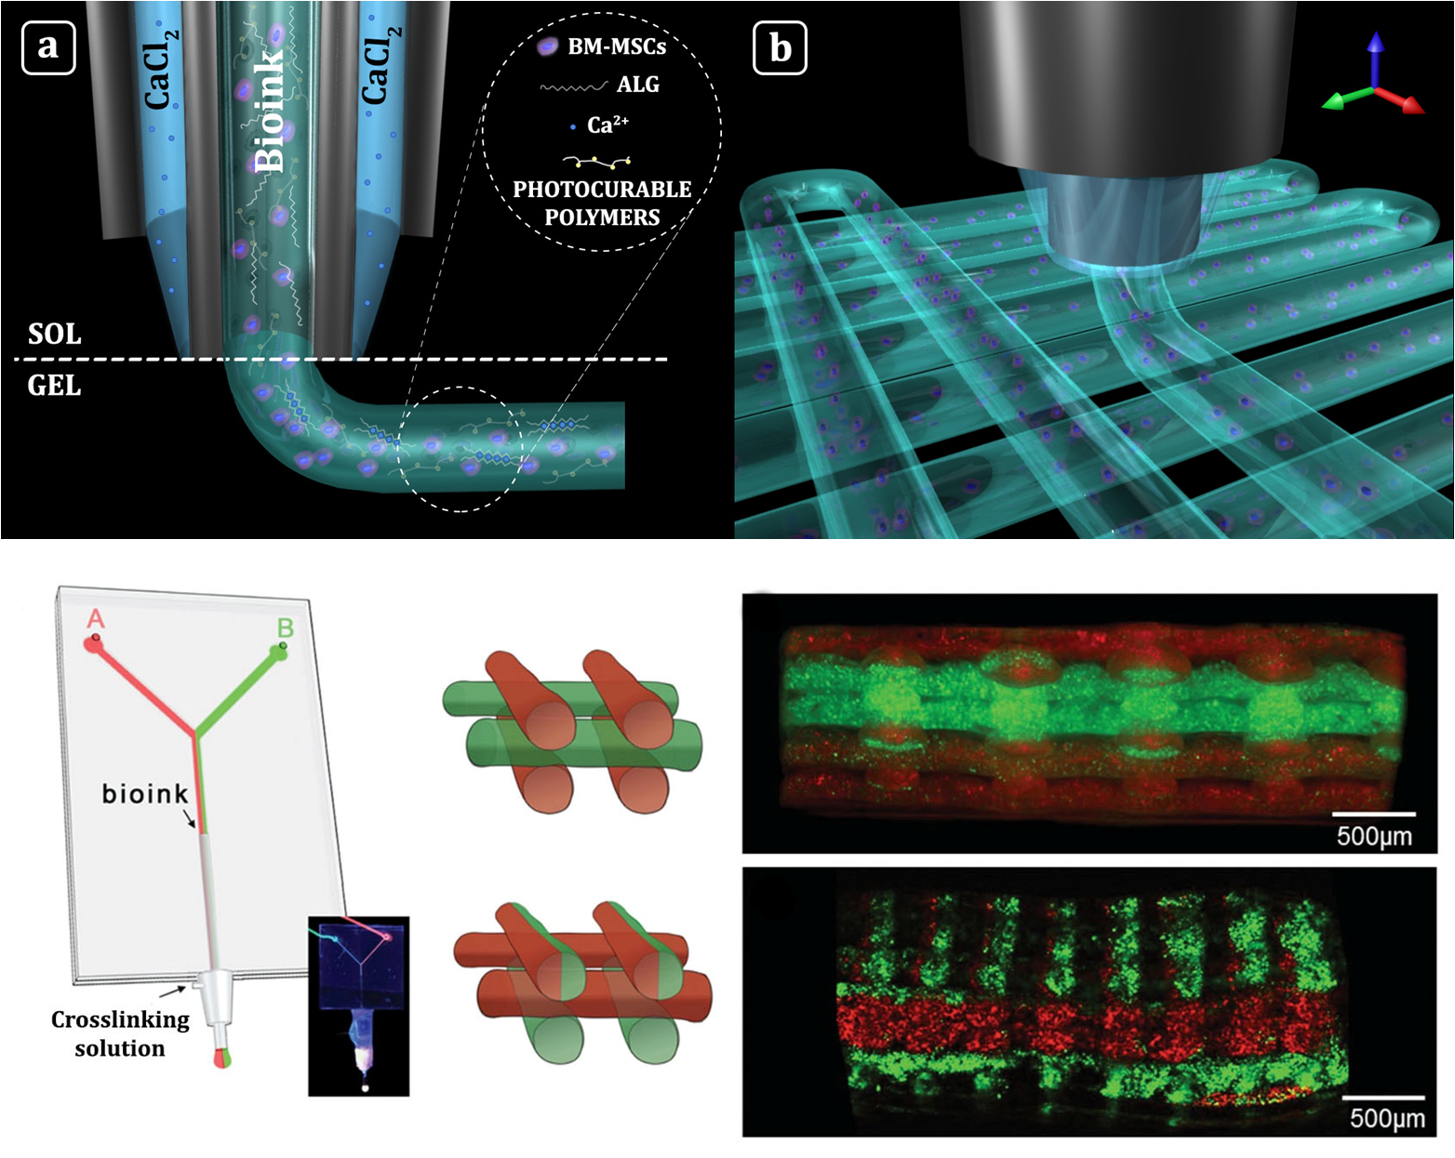
MICROFLUIDIC ASSISTED BIOPRINTING
Convergence between microfluidics and additive manufacturing.
At the heart of the process, there is a microfluidic printing head, with a multi-inlet configuration and terminated with a coaxial needle.
Bioink contains alginate as a gelling agent, in blend with photo-curable biopolymers (methacrylate derivatives) and a photo-catalyst.
              Bioink is extruded through the inner needle, while a Ca⁺⁺ solution is fed through the outer needle
              Instant gelation of the bioink, which is extruded as a single fiber
              Post-process curing by mild UV (365 nm) irradiation.
The process is cell compatible and multi-material cell-laden constructs can be obtained.

Slide 15
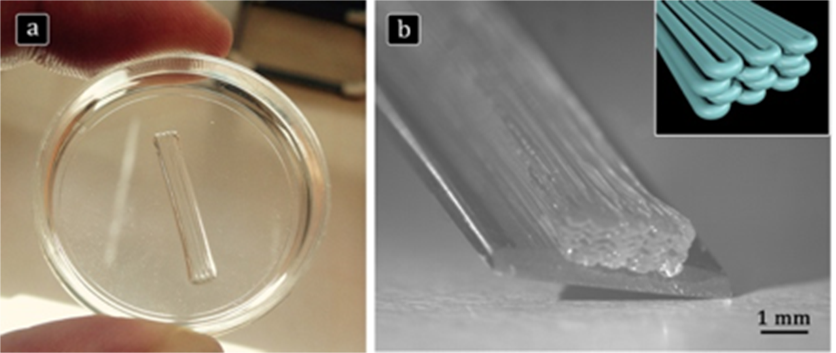
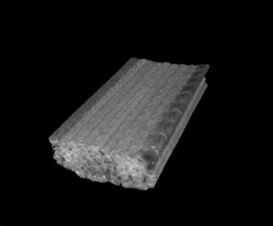
OUTLOOK – SKELETAL MUSCLE REGENERATION
Microfluidic assisted bioprinting of C2C12 murine myogenic cell line using PEG-Fibrinogen photo-curable bioink.
RATIONALE: mechanical confinement of cells into highly aligned hydrogel fibers may be sufficient to drive cell fusion and alignment.

Slide 16
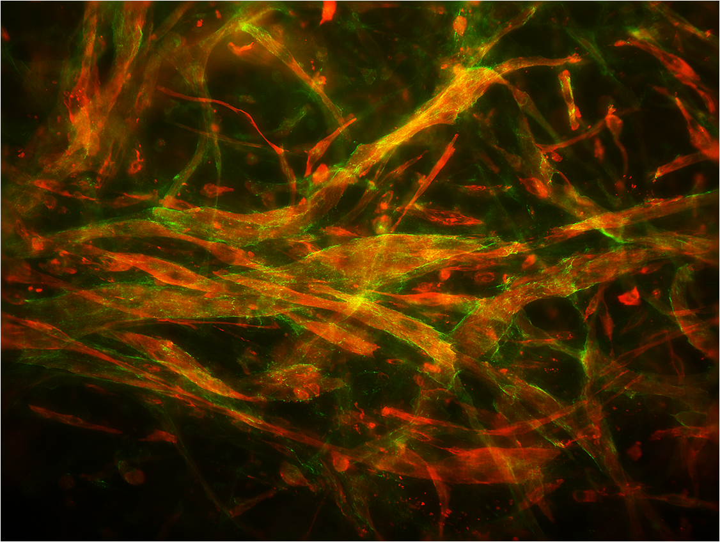
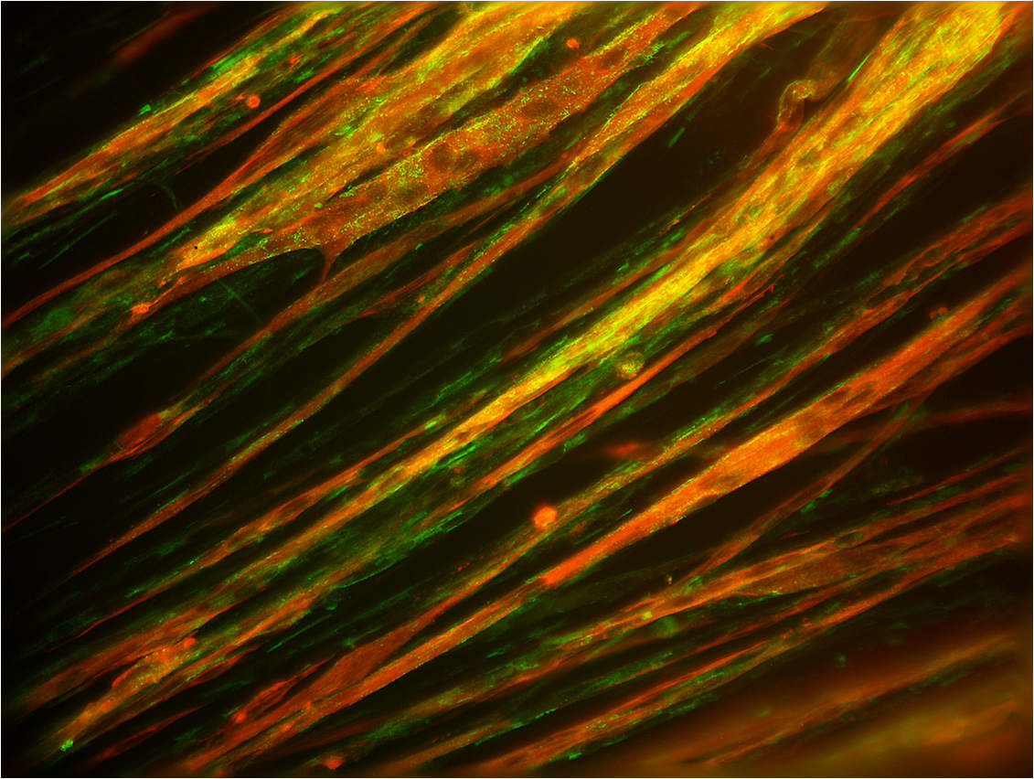
MYOGENIC POTENTIAL – IN VITRO
CAST HYDROGEL
BIOPRINTING
myosin heavy chain
laminin

Slide 17
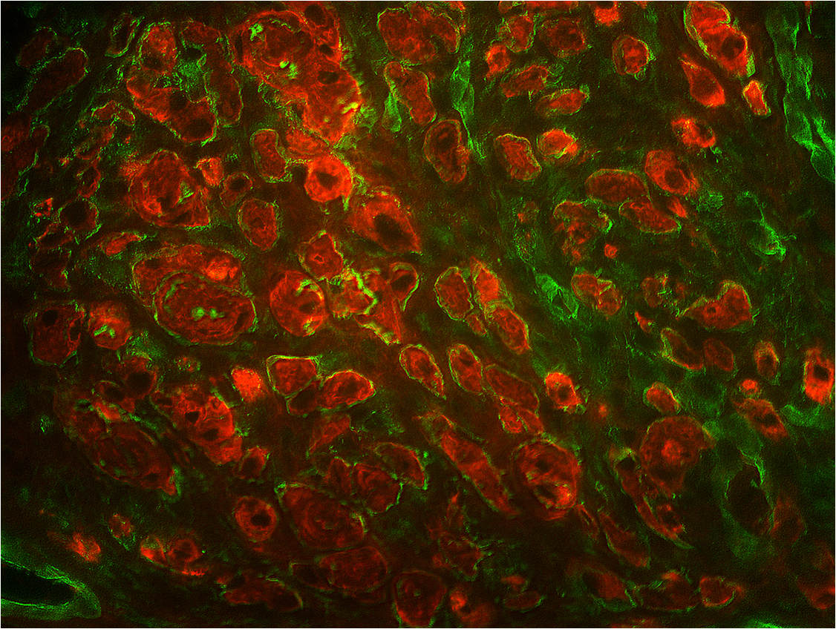
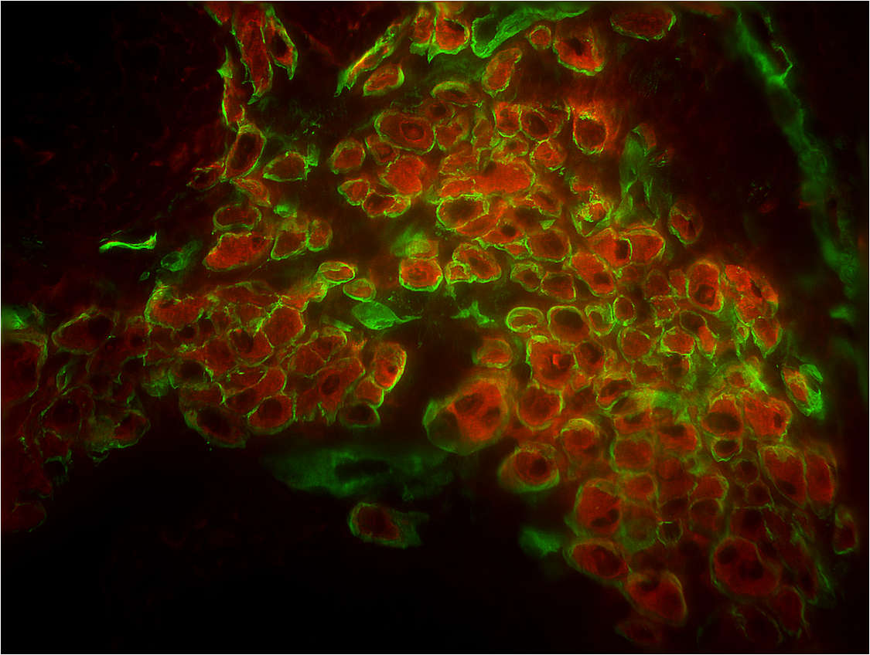
MYOGENIC POTENTIAL – IN VIVO
Transverse sections
CAST HYDROGEL
BIOPRINTING
myosin heavy chain
laminin

Slide 18
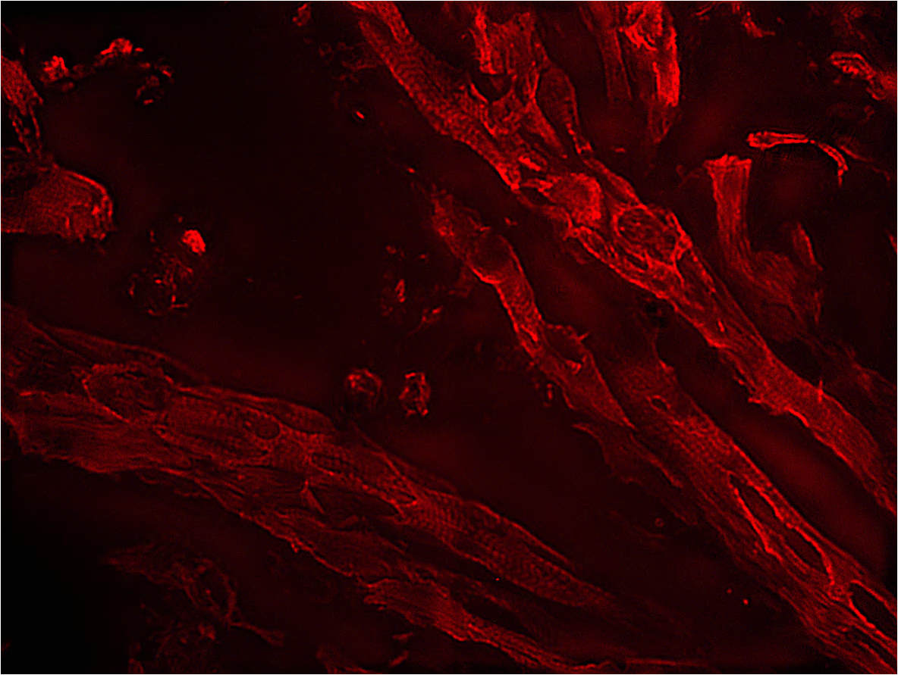
MYOGENIC POTENTIAL – IN VIVO
Longitudinal section
BIOPRINTING
myosin heavy chain

Slide 19

TAKE-HOME MESSAGE
Technological advances introduced by improved manufacturing techniques may play a role in the diffusion of tissue engineering approaches for regenerative medicine.

Slide 20
ACKNOWLEDGEMENTS
Tissue Engineering Unit @ UCBM
Marcella TROMBETTA
Francesco BASOLI
Marco COSTANTINI
Sara M. GIANNITELLI
Pamela MOZETIC
Manuele GORI
Franca ABBRUZZESE
Claudia CICIONE
Maria Chiara SIMONELLI
COLLABORATIONS
Univ. Tor Vergata (Sivia Licoccia, Cesare Gargioli, Stefano Cannata)
IFN-CNR (Luca Businaro, Annamaria Gerardino, Francesca R. Bertani, Adele De Ninno)
Politecnico di Torino (Valeria Chiono, Gianluca Ciardelli)
ENEA Casaccia (Antonio Rinaldi)
Univ. Bari (Antonio Scilimati, Maria Grazia Perrone)
Sapienza Univ. Roma (Mariella Dentini, Andrea Barbetta)
FNUSA-ICRC, Brno (Giancarlo Forte, Vladimír Vinarský)
Warsaw Univ. Technology (Jakub Jaroszewicz)
FAU Erlangen-Nürnberg (Aldo R. Boccaccini)
Units @ UCBM
Translational Oncology
Biochemistry & Molecular Biology
Nonlinear Physics & Mathematical Modeling
Gastroenterology Unit
Microscopic & Ultrastructural Anatomy
Medical Laboratory
Cardiac Surgery
FUNDING
MIUR PRIN 2010/11; PRIN 2012
MIUR FIRB Futuro in Ricerca 2010
RICERCA FINALIZZATA RF 2011/12
AIRC MFAG2015
UCBM - bando interno

Slide 21
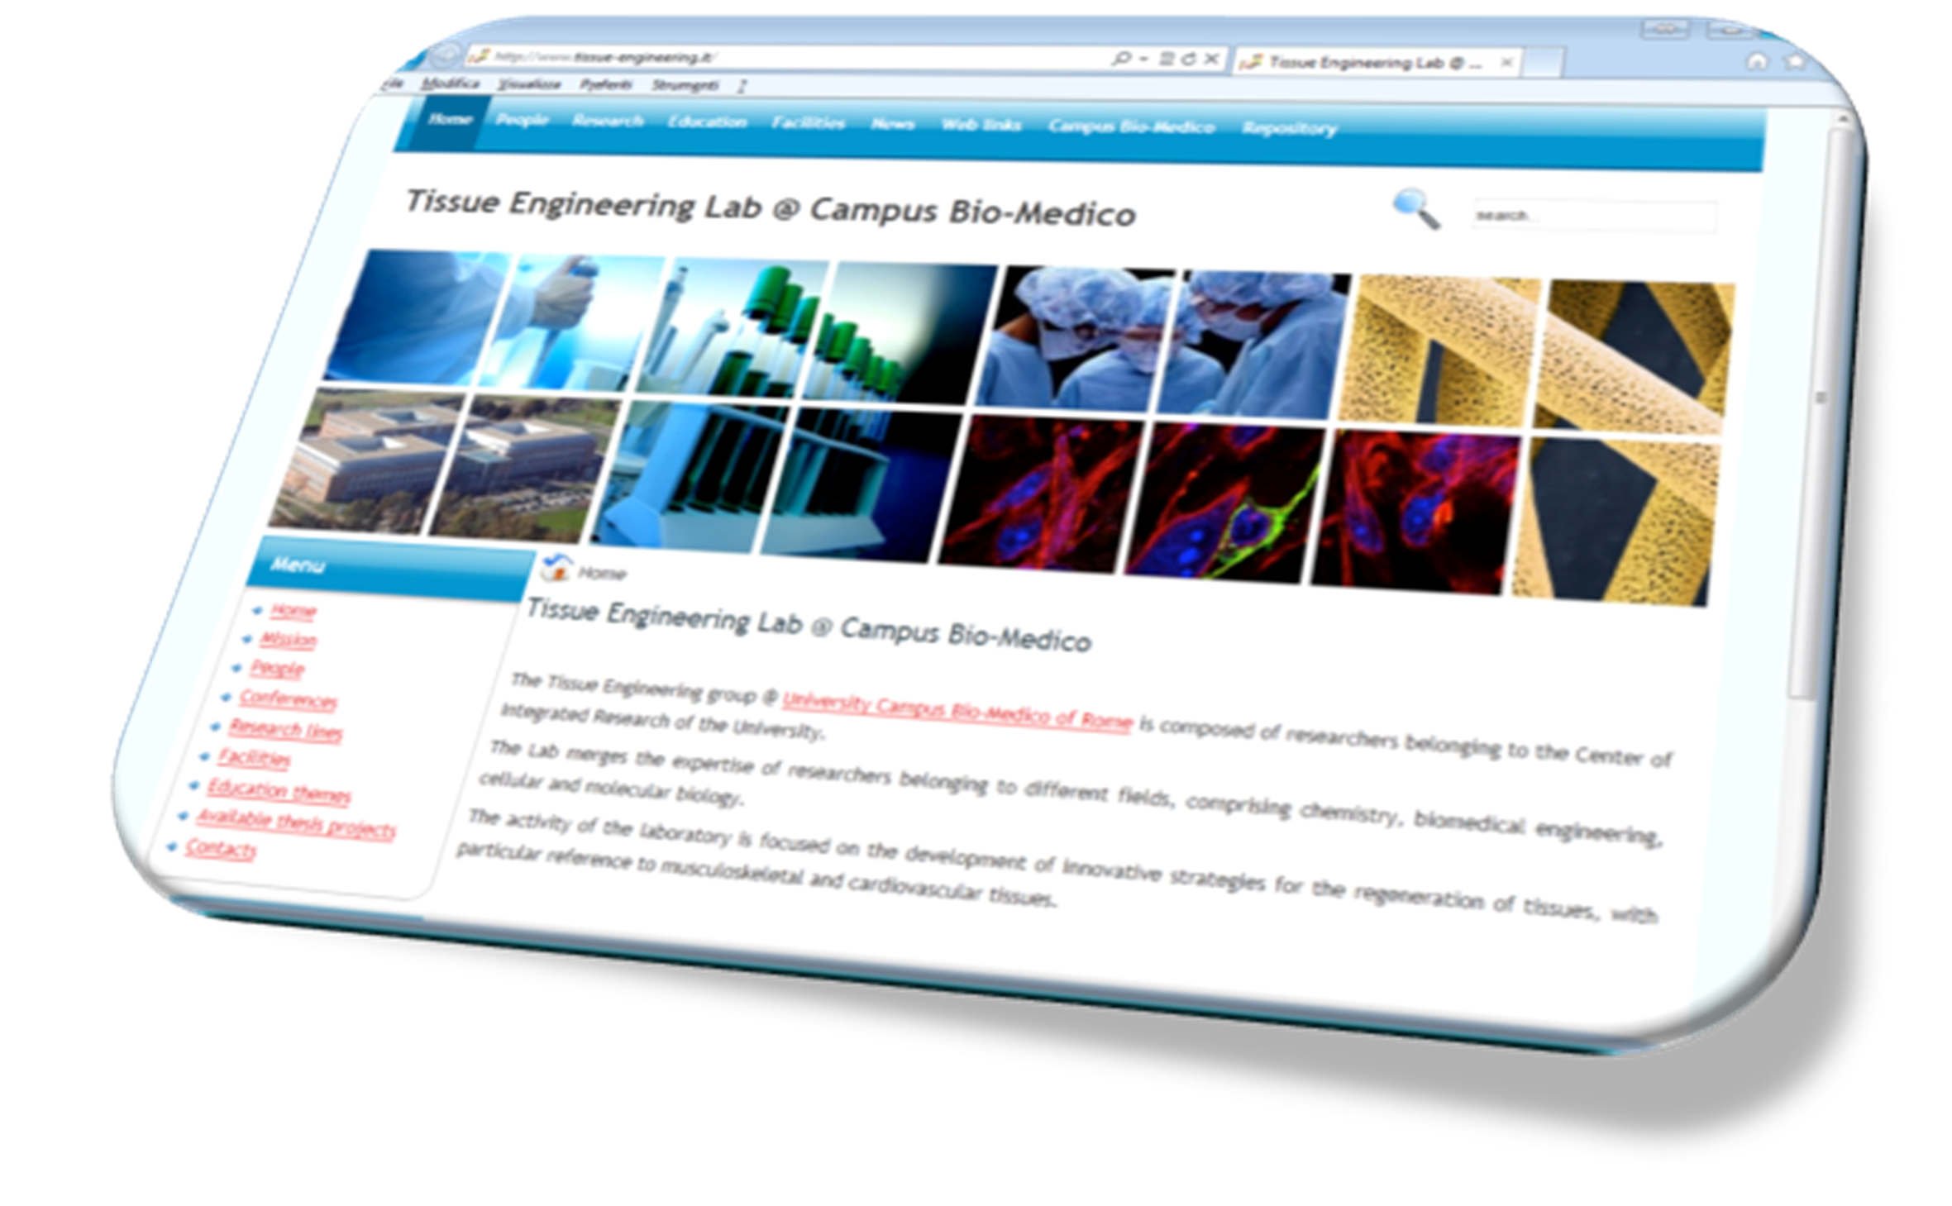
WEBSITE: www.tissue-engineering.it

